Slide 1


Slide 2
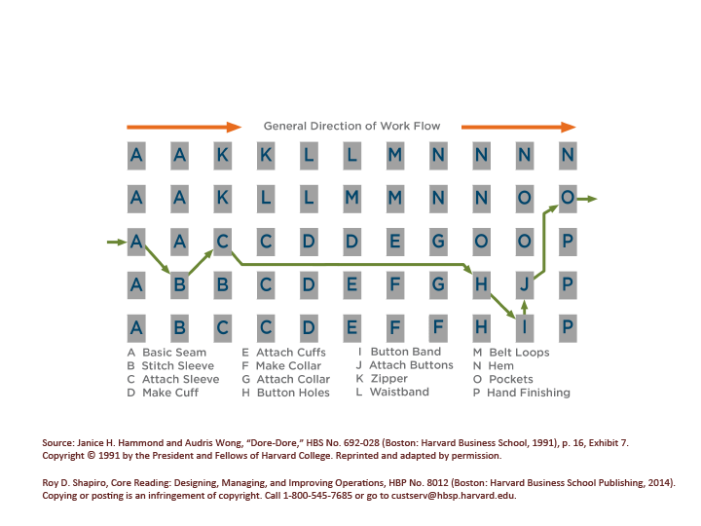
Jumbled Process Flow

Slide 3
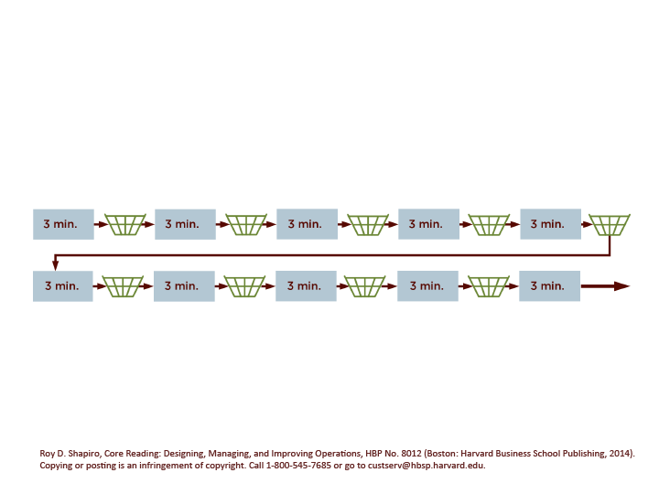
Ten-Step Sequential Process

Slide 4
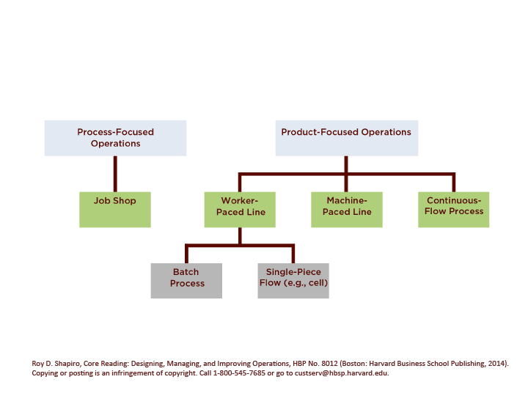
Taxonomy of Process Types

Slide 5
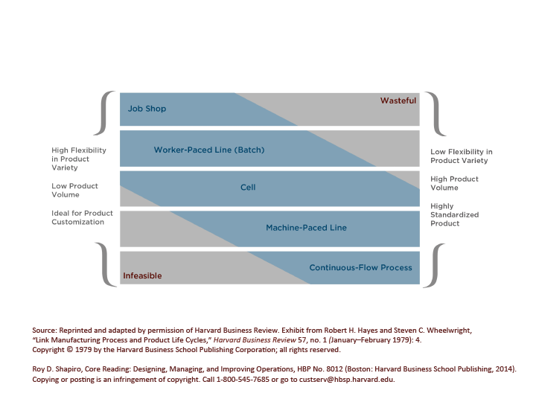
Product-Process Matrix

Slide 6
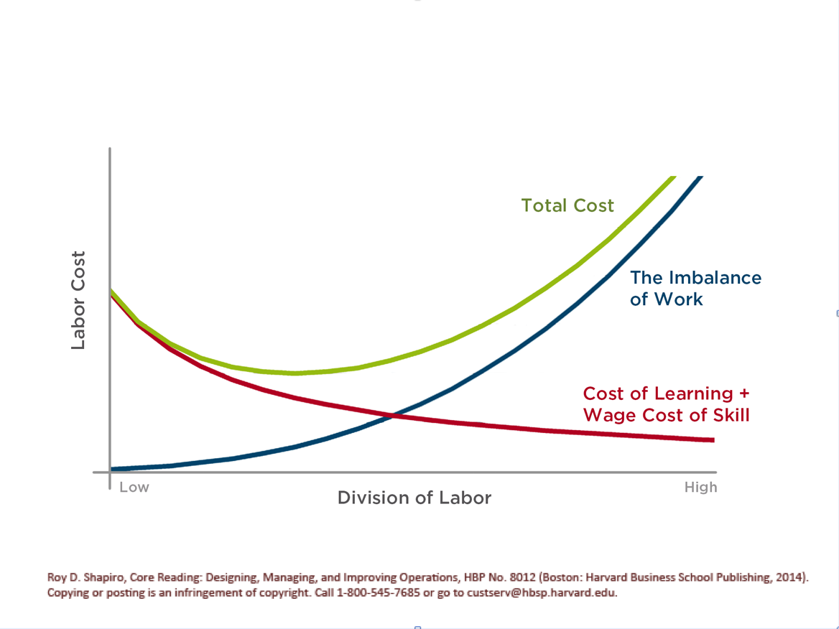
Costs for Increasing Division of Labor

Slide 7
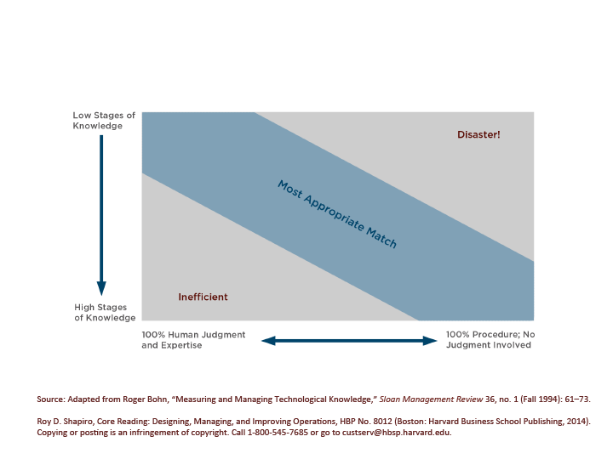
Degree of Proceduralization

Slide 8
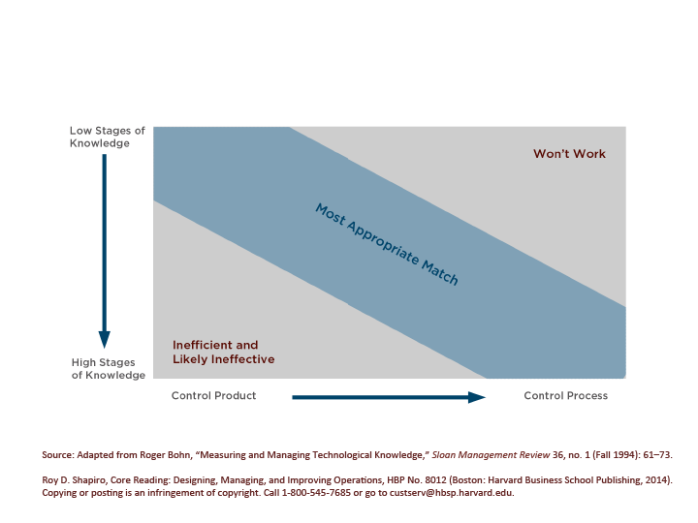
How Best To Manage Quality

Slide 9
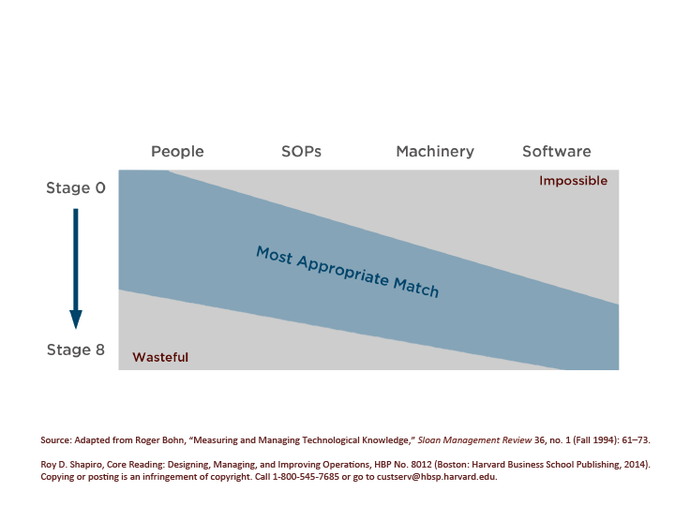
Where Knowledge Resides

